Slide 1

BDM 411 BUSINESS INTELLIGENCE AND ANALYTICS LECTURE 2: INTRODUCTION TO BUSINESS INTELLIGENCE AND ANALYTICS

Slide 2
DEFINITION OF BUSINESS INTELLIGENCE
Information technology which provides decision makers with valuable information and knowledge by leveraging a variety of data sources as well as structured and unstructured information.
Data sources- external or internal to the organization
Information- quantitative or qualitative
Output: Knowledge- Organized information
Input: Information and data
Business intelligence tools: used in BI solutions
Business solutions: support the BI process

Slide 3
DEFINITION OF BUSINESS INTELLIGENCE
BI refers to application and technology, which is used to gather, provide access to, and analyze data and information about the company operations
BI is neither a product or a system. It is an architecture and a collection of integrated operational as well as decision-support applications and databases that provide the business community easy access to business data.

Slide 4
Benefits of BI in Organizations
Companies can benefit from BI Solutions in more ways than one. Here are some beneficial and effective methods:
Customer loyalty can be achieved in the way that Target was brought up before. By on-boarding customers early, you may be able to retain them for years. If companies use data mining to provide consumers with what they want or need before they even realize they want or need it, that consumer will have the company on high alert in their mind—whether it’s subconscious or not.
Sales forecasting observes the product that a customer purchased, and tries to predict when they may buy it again. This helps when companies want to plan to sell to phase a product out, or when trying to determine complimentary products to sell.

Slide 5
Benefits of BI in Organizations
Market segmentation is when a company categorizes its market into segments such as age, gender, job, marital status, income, etc. This is an effective strategy on many levels, and it can even help a company understand its competitors in each of these segments. Market segmenting a database can improve a company’s conversion rates and can help companies customize products to further engage their demographics.
Merchandise planning can help a brick-and-mortar business determine stocking and inventory options. By knowing data information of how much of a certain product customers purchase, companies can know how much they need of it. Merchandise planning also assists companies in knowing what to do with inventory that is getting old, intelligence on competitor merchandise, balancing stock, and pricing based on customer sensitivity.

Slide 6
Benefits of BI in Organizations
Product production, wherein a company predicts features and products that their consumers may want. BI Solutions will reveal customer pain points, leaving it up to the company to provide that customer with the answer to that pain point with a viable product that will solve that problem in a way the customer never imagined.
The more data a company collects from customers, the more value it can deliver to them.
Affinity analysis or “basket analysis” (referring to a check-out basket online) allows a company to see what a consumer purchased and predict what that consumer may want in the future based on their preferences. This analysis evaluates the use of credit cards and patterns of phone use, and can reveal information such as if a consumer needs constant incentives to stick around, such as upgrades or new features. It can also answer questions like: Do people who buy item A also buy item B? Which one did they buy first, and why? Could we encourage customers to buy A, B, and C, thus boosting point-of-purchase sales?

Slide 7
Benefits of BI in Organizations
Management effectively aided
Intellectual capital better deployed
Business operations improved
Customer service enhanced
New opportunities identified

Slide 8
DATA ENGINEERING
Data engineering is a set of operations aimed at creating interfaces and mechanisms for the flow and access of information. It takes dedicated specialists—data engineers—to maintain data so that it remains available and usable by others. In short, data engineers set up and operate the organization’s data infrastructure, preparing it for further analysis by data analysts and scientists.
—From “Data Engineering and Its Main Concepts” by AlexSoft

Slide 9
DATA ENGINEERING
Data engineering is the development, implementation, and maintenance of systems and processes that take in raw data and produce high-quality, consistent information that supports downstream use cases, such as analysis and machine learning. Data engineering is the intersection of security, data management, DataOps, data architecture, orchestration, and software engineering. A data engineer manages the data engineering lifecycle, beginning with getting data from source systems and ending with serving data for use cases, such as analysis or machine learning.
(Reis & Housley, 2022)

Slide 10
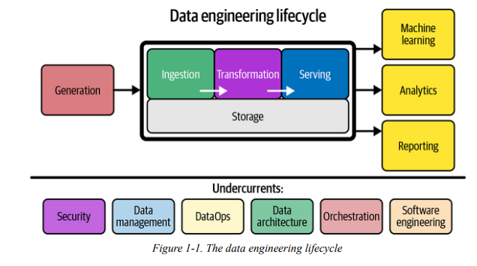
DATA ENGINEERING LIFECYCLE

Slide 11
DATA ENGINEERING LIFECYCLE
We begin the Data Engineering Lifecycle by getting data from source systems and storing it. Next, we transform the data and then proceed to our central goal, serving data to analysts, data scientists, ML engineers, and others. In reality, storage occurs throughout the lifecycle as data flows from beginning to end—hence, the diagram shows the storage “stage” as a foundation that underpins other stage
Acting as a bedrock are undercurrents that cut across multiple stages of the data engineering lifecycle: security, data management, DataOps, data architecture, orchestration, and software engineering. No part of the data engineering lifecycle can adequately function without these undercurrents

Slide 12
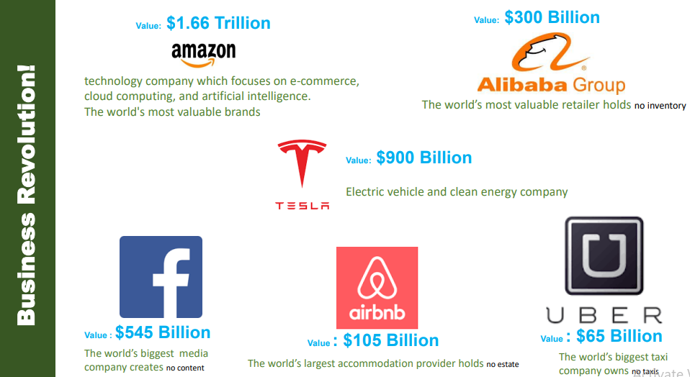
Digital Transformation and BI Solutions

Slide 13
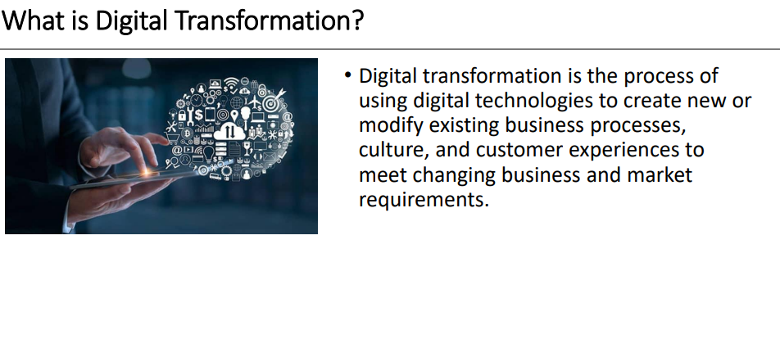

Slide 14
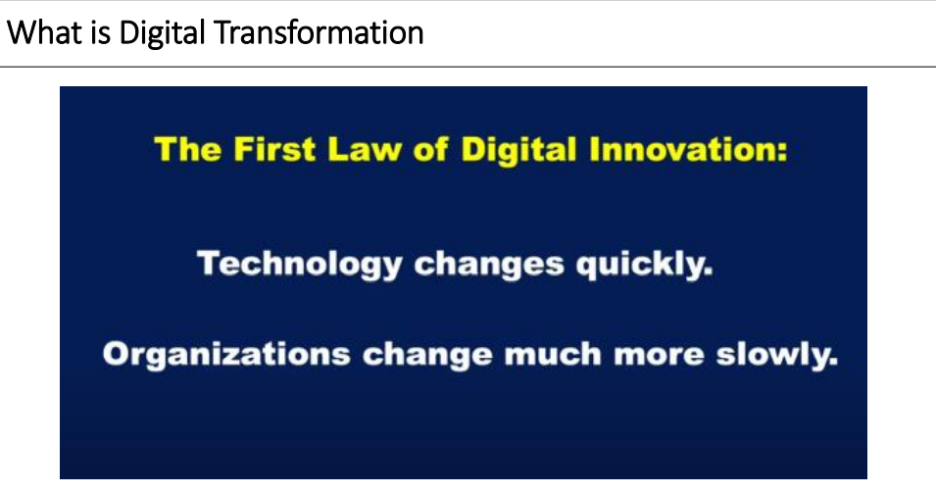

Slide 15
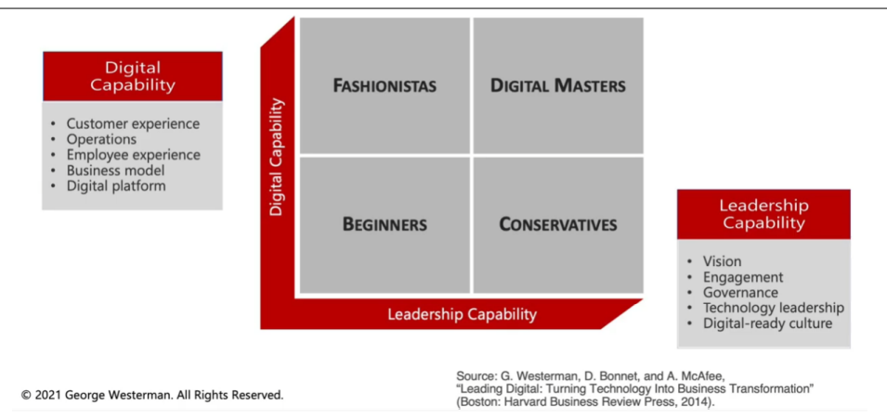
DIGITAL TRANSFORMATION

Slide 16
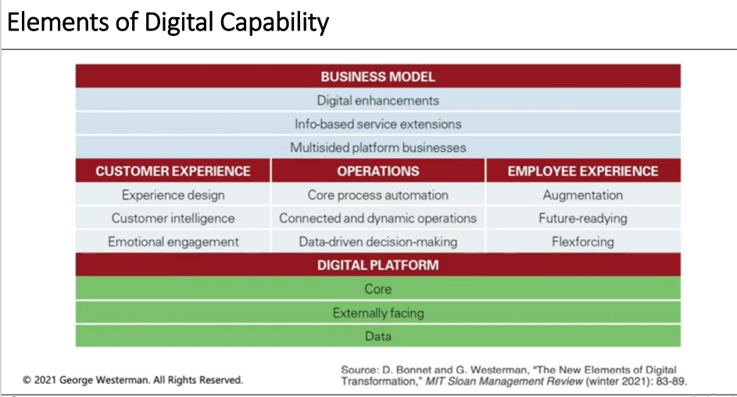

Slide 17
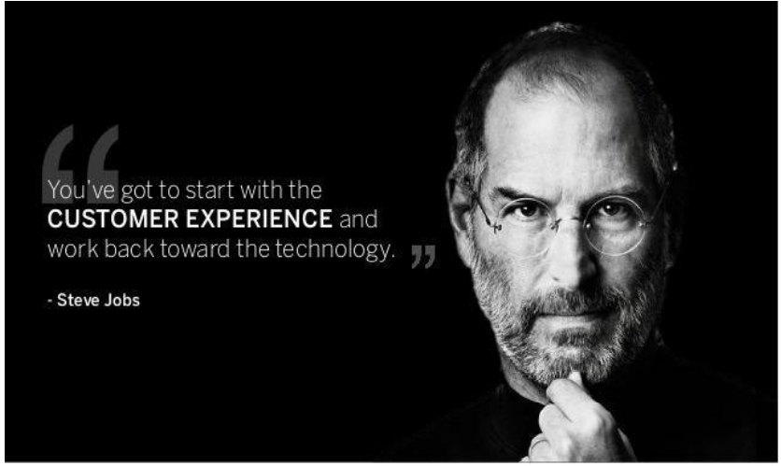
Customer experience and BI

Slide 18
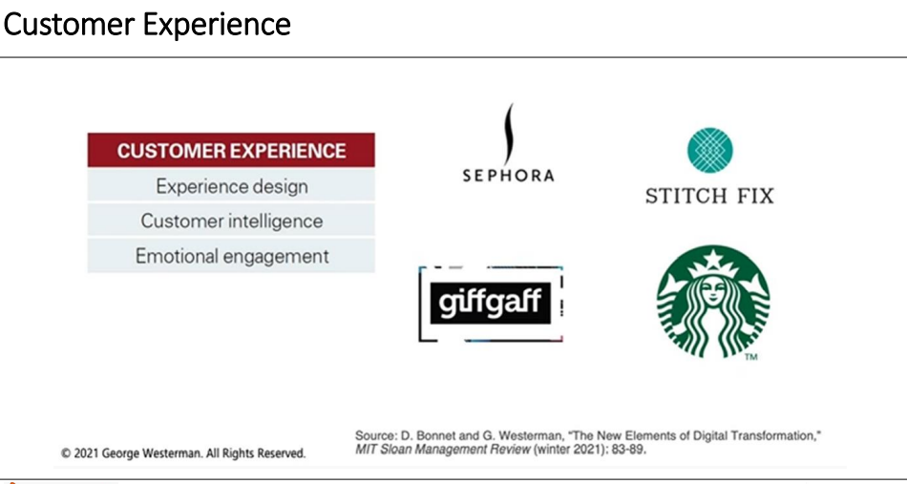

Slide 19
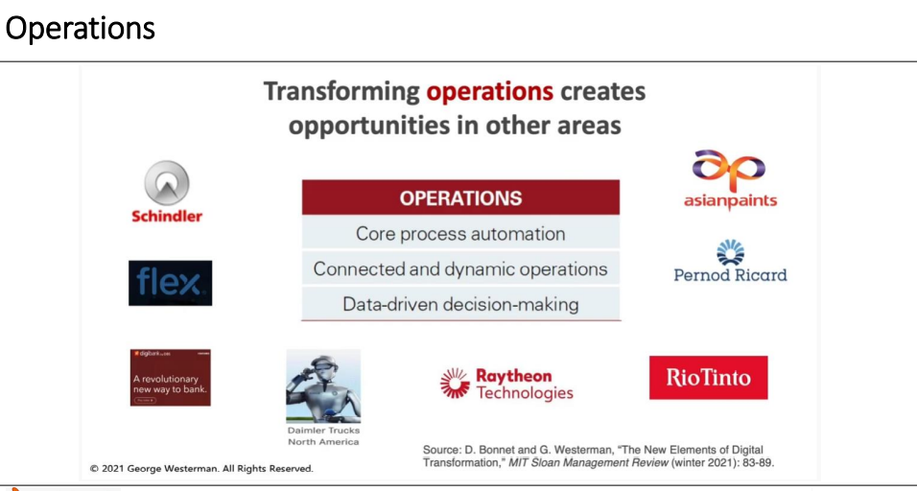

Slide 20
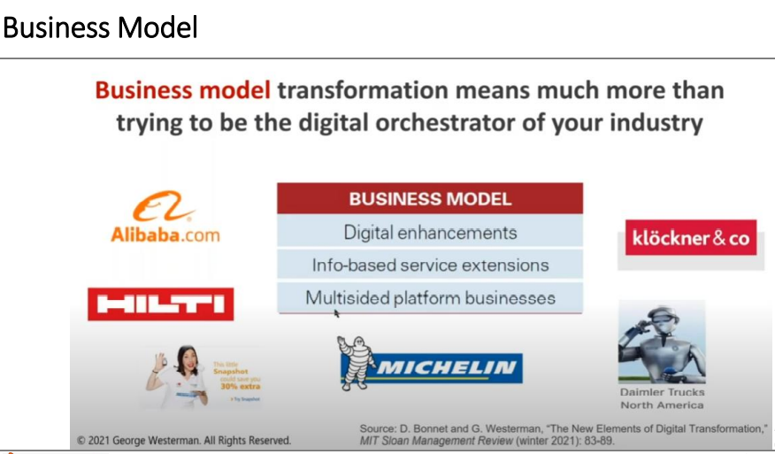

Slide 21
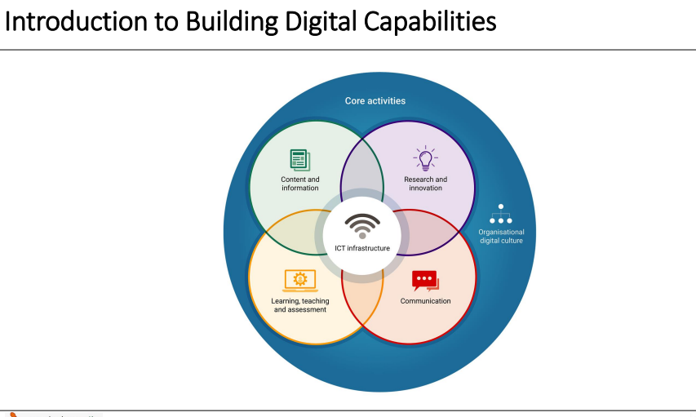

Slide 22
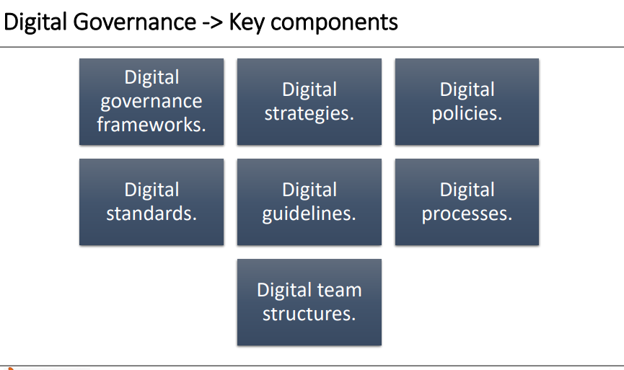

Slide 23
Top 10 Analytics and Business Intelligence Trends 2019
Here are the top 10 analytics and business intelligence trends we will talk about in 2019:
Data Quality Management
Data Discovery
Artificial Intelligence
Predictive and Prescriptive Analytics Tools

Slide 24
Top 10 Analytics and Business Intelligence Trends 2019
Here are the top 10 analytics and business intelligence trends we will talk about in 2019:
Connected Clouds
Data Governance And Trust
Security – Digital Ethics And Privacy
Growing Importance of the CDO & CAO
Collaborative Business Intelligence
Consumer Experience

Slide 25
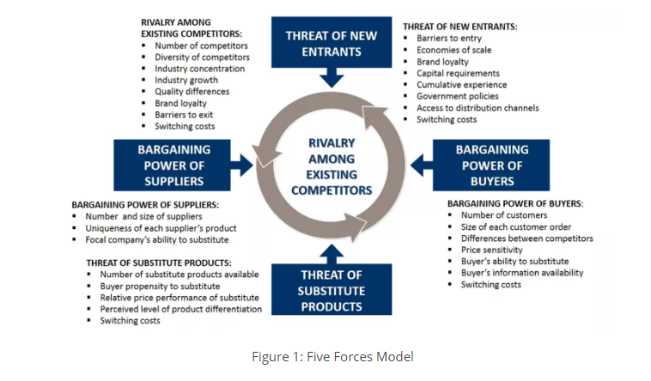
Porters Five Forces
NB: Review questions are for your own revision and not to be done as an assignment

Slide 26
REVIEW QUESTIONS
Discuss the relationship between Digital transformation and Business Intelligence
Summarize the benefits of Business intelligence in an organization in the 21st Century
Discuss the Porters Five Forces in relation to the Business intelligence
Choose one Sector of Economy in Kenya and discuss how Business Intelligence has been used to achieve efficiency in Operations

Slide 27
CASE STUDY
From the Case Study:
ADDRESSING 4 CORE BUSINESS INTELLIGENCE CHALLENGES ON THE SEARCH FOR ACTIONABLE INSIGHTS By Jennifer Bresnick
Discuss the four Core Business Intelligence Challenges faced by the organizations today.
Propose the specific solutions to the above challenges

